Slide 1
Week1 :Food Costs in Canada
By
Hajar Kaddouri

Slide 2
The food cost in canada
In Canada, the cost of red meat and poultry has seen fluctuations in recent years. Various factors can be included : production costs, supply chain dynamics, and market conditions, contribute to the changing prices of these protein sources.

Slide 3
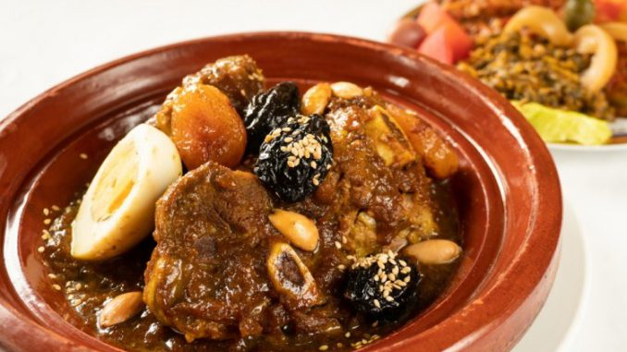
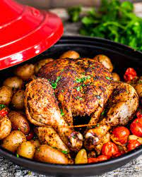
Datasets
Price Reports
Red meat and livestock
Poultry

Slide 4
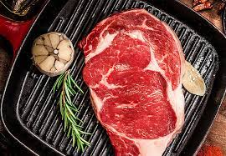
Red meat and livestock
Cattle/Beef
Calves (from birth to about 12 months)
Veal (3 and 18 weeks)
Grain fed Veal
Milk fed Veal
Veal (male & female) Quebec & Ontario
Hogs/Pork
Hogs (pig, regardless of gender)
Sows (mature, adult female pig)
Boars (mature, adult male pig)
Sheep, lamb and goat
Lamp (many sizes)
Sheep
Ews(adult female sheep)
Ram(adult male sheep)
https://agriculture.canada.ca/en/sector/animal-industry/red-meat-and-livestock-market-information/prices

Slide 5
Cattle/Beef
Number sold
Average Price
More Informations
1
Calves
November 2023 (per month)
From Quebec
M(90lb-120lb),(121lb-140lb)
F(100lb-140lb)
2
Grain fed Veal
All months
2023 & 2022
From Quebec
3
Milk fed Veal
No informations
4
Veal(Male & female )
All months 2023
Per 100lb
Quebec & ontario

Slide 6
Hogs/Pork
Number sold
Average Price
More Informations
1
Hogs &Sows &Boars
Monthly
Last 5 years
Per 100kg
All provinces
Sheep, lamb and goat
Number sold
Average Price
More Informations
1
Lamb
All months
2023
Ontario (80-110lb)
Quebec & ontario (under 79lb)
2
New crop lamps
All months
2023
Ontario & Quebec
3
Ews & Ram(Sheep)
All months
2023
Quebec
4
All weights (Sheep)
All months
2023
ontario

Slide 7
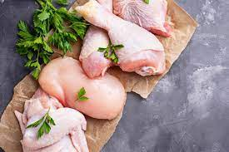
Poultry
Table eggs
Grade A(EL, J, L, M,PP,S)
Grade B
Grade C
Chicken
Less than 1,4kg
1,4 tp 2,7 kg
More than 2,7
Turkey
6,2 kg and under
6,2 kg to 8,5kg
8,5 kg to 10.8kg
10,8 kg to 13,3 kg
Over 13,3kg
https://agriculture.canada.ca/en/sector/animal-industry/poultry-and-egg-market-information/prices

Slide 8
Chicken
Number sold
Average Price
More Informations
1
Less than 1,4kg
1,4 tp 2,7 kg
More than 2,7
Producer prices
All months
2023
Price per kilo
All province
Turkey
Number sold
Average Price
More Informations
1
6,2 kg and under
6,2 kg to 8,5kg
8,5 kg to 10.8kg
10,8 kg to 13,3 kg
Over 13,3kg
Producer prices
All months
2023
Price per kilo
All province

Slide 9
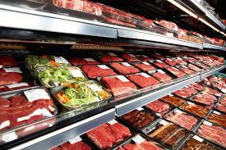
Links
AgriCanada - Red meat and livestock price report: https://agriculture.canada.ca/en/sector/animal-industry/red-meat-and-livestock-market-information/prices
AgriCanada - Poultry price reports: https://agriculture.canada.ca/en/sector/animal-industry/poultry-and-egg-market-information/prices

Slide 10

Challenges
Lb Vs Kg
Other provinces
duration

Slide 11

THANKS

